Slide 1

SVM Classifier
INFO 6105

Slide 2

Problem Statement
Implement SVM classifier on Loan dataset

Slide 3

Technical Approach for SVM Classification
Import
Import Loan Data
Process
Process Data (insert dummies & drop unrelated columns)
Implement
Implement Regression analysis
Create
Create test-train split for model
Train
Train model for linear, rbf and polynomial kernel
Run
Run data on test dataset and plot the results

Slide 4
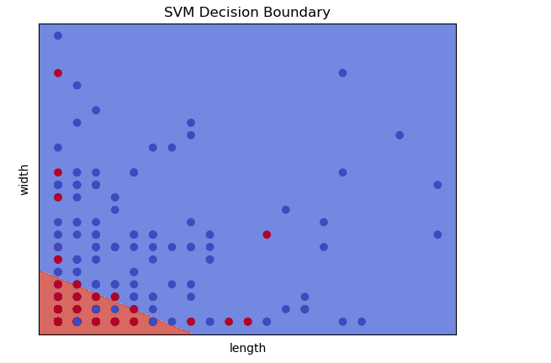
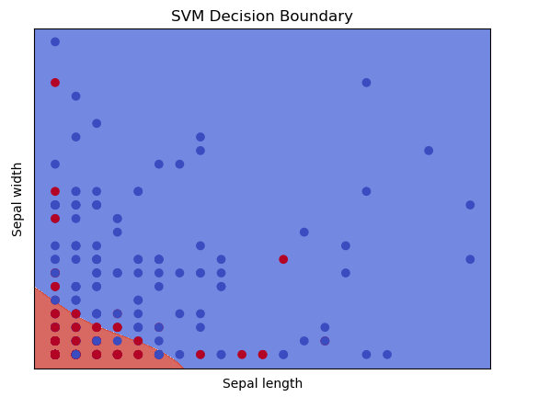
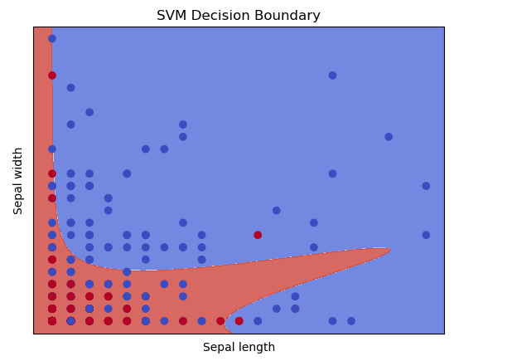
Results
Linear Kernel
RBF Kernel
Polynomial Kernel

Slide 5
Conclusion
By this assignment, we came across SVM classifier for Linear, RBF and Polynomial kernel.
We observed the accuracy to have maximum in svm classifier over linear kernel

